Slide 1
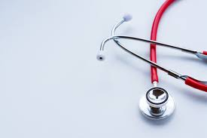
BASIC FIRST AID
Submitted by,
Department of Hospital Administration
Seethalakshmi Ramaswami College
Trichy

Slide 2
FIRST AID
Introduction:
It uses the available human and material resources at the site of accident to provide initial care

Slide 3
FIRST AID
Definition:
“Measures to be taken immediately after an accident not with an idea to cure but in order to prevent further harm being done".

Slide 4
OBJECTIVES OF FIRST AID
(i) To preserve life
(ii) To prevent the victim's condition from worsening
(iii) To promote recovery

Slide 5
SCOPE OF FIRST AID
DIAGNOSIS
The First Aider should examine the casualty to know the details of injuries and their nature
TREATMENT
Treatment to be given until the doctor takes charges
DISPOSAL
To send the casualty to his house or to a Hospital.

Slide 6
ASSESS THE SCENE
Evaluate the scene
Assess safety
Prioritize care
Check for medical alert tags
Do head-to-toe check
Move only if necessary

Slide 7
ABC OF FIRST AID
The ABC of basic life support (Airway, Breathing, and Circulation)
Airway must be open so that air containing oxygen enters the body
Breathing must take place so that oxygen passes through the lungs into the blood stream
The heart must circulate the oxygen carrying blood

Slide 8
RULES OF FIRST AID
Reach the accident spot quickly.
Be calm methodically and quick
Look for the following
-Is there severe bleeding
-Is the shock light or severe.
Start artificial respiration
Stop bleeding by pressing on the point.

Slide 9
RULES OF FIRST AID
Treat for shock
Avoid handling the casualty unnecessarily
Inspect the area
Clear the crowd with nice word
Note the weather
Reassure the casualty
Arrange for dispatch
Do not attempt too much.

Slide 10
CONTENTS OF A FIRST AID KIT
Cotton wool
Adhesive tape
Crepe bandage
Sterile Dressing
Bandage
Thermometer
Scissors
Glove
Soap
Pain reliever
Antacid
ORS Packets

Slide 11
FAINTING
Fainting is a brief loss of consciousness
causes :
fainting
head injury
epilepsy
stroke
poisoning
diabetes
conditions associated with lack of oxygen.

Slide 12
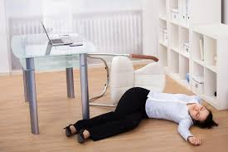
FAINTING
Do’s :
Catch the person before he/she falls
Pinch the person and see if she moves or opens her eyes
Examine the injuries and causes of unconsciousness
Tilt head back and keep arms at right angle to body
Raise the legs 8 – 12 inches. This promotes blood flow to the brain.
Loosen any tight clothing
Keep the victim warm if it is cold outside
Keep a record of the casualty’s condition

Slide 13
FAINTING
Don’t give the patient anything to eat or drink
Don’t allow the person who has just fainted to get up
Don’t crowd around the victim
Don’ts :

Slide 14
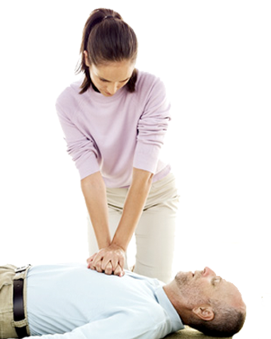
ADMINISTER CPR
Lay the person on his or her back
Give chest compressions
Tilt head slightly
Breathe into the person’s mouth
Continue until Medical personnel arrive

Slide 15
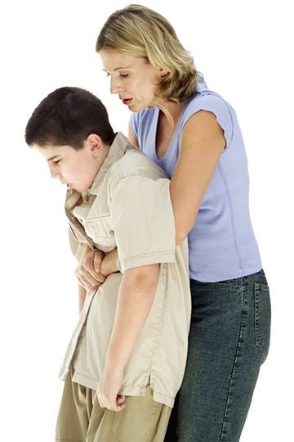
CHOKING
Ask a person to speak or cough
Deliver 5 back blows
Perform abdominal thrusts
Repeat sequence of back
blows and abdominal thrusts

Slide 16
STITCH
Stitch is a painful spasm of the diaphragm it happen during game and running.
Rest the patient
Give him sips of hot water
Gently rub the affected area of the abdomen

Slide 17
CRAMP
An involuntary contractions of the muscle is called cramp.
This may be happened during exercise or by chilling
Stretch the shortened muscle
Massage the affected part and apply warmth

Slide 18
BLEEDING
Cuts, scrapes and puncture can result in bleeding.
Direct pressure Elevation - Lie victim down and raise the injured part above the heart and handle gently if you suspect a fracture.
Bandaging is done to stop bleeding and to stop dirt infecting the wound.

Slide 19
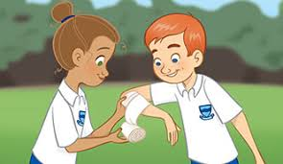
FRACTURE
Fracture refers to an injury affecting the skeleton and can be caused by the application of direct and indirect force.

Slide 20
FRACTURE
Signs and Symptoms:
Pain at or near the site of injury increased by movement.
Movement may be difficult or impossible
Swelling and later bruising of the injured part
Deformity at the site of the fracture
Shock may occur

Slide 21
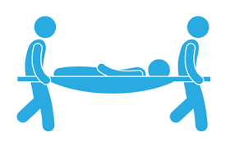
FRACTURE
Do’s :
Check the danger, response, airway, breathing and the blood circulation of the victim
Always control severe bleeding before immobilizing any fractures
Place sufficient padding to support fracture site

Slide 22
FRACTURE
Do’s :
Immobilize fracture sites
Do not force bones back into the wound
Give proper padding before the patient is shifted to the hospital
Apply ice pack on the affected area to reduce pain and control swelling
Treat to prevent shock

Slide 23
DISLOCATIONS
A dislocation is the displacement of one or more
bones at a joint. It usually occurs in the shoulders,
elbow, thumb, fingers and the lower jaw.
SYMPTOMS:
Pain at the site of injury
Limited movement at joint
Deformity
Swelling
Tenderness

Slide 24
FRACTURES AND DISLOCATIONS
TREATMENT:
Support and immobilize the injured limb
Use a splint (if possible) in order to prevent movement of the injured part
Arrange for casualty to be removed to hospital
In doubtful cases, always treat as for a fracture
Do not attempt to replace the bones

Slide 25
STRAINS
A strain is an injury to a muscle in which the
Muscle fibres tear as a result of overstretching.
(Sprain – to a ligament)
SYMPTOMS:
Localised pain
Stiffness
Inflammation
Bruising

Slide 26
SPRAINS
A sprain occurs at a joint where there is
tearing or over-stretching of the ligaments
and tissues.
SYMPTOMS:
Pain at site of injury
Swelling and later bruising
Pain on movement
Loss of function

Slide 27
SPRAINS
TREATMENT:
Support the joint in most comfortable position
P.R.I.C.E. (Protect, Rest, Ice, Compression, Elevation) treatment
When a sprained ankle occurs outdoors, do not remove the shoe
If unsure whether there is a fracture, always assume it is one

Slide 28
DEHYDRATION
Dehydration means loss of salt and water in the body
ORS has been a lifesaver in case of dehydration .
ORS is prepared by dissolving a pinch of salt in a glass of water and one tablespoon of sugar to it.
ORS helps in restoring back the electrolyte balance of our body and re-hydrate it.

Slide 29
HEAT EXHAUSTION
Move to cool place
Lay victim down
Elevate feet
Loosen clothing
Give fluids
Apply cool compresses

Slide 30
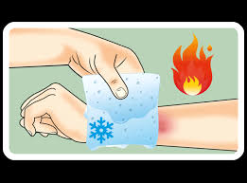
BURNS
Damage to the skin or other body parts caused by extreme heat, flame, contact with heated objects, or chemicals
Dry burn
Caused by flame, contact with hot objects, friction etc.
Scalds
Contact with steam and hot fluids
Electrical burn
Low-voltage current, lightning strike
Cold injury
Contact with freezing metals, dry ice,
freezing vapours
e.g. liquid oxygen and liquid nitrogen

Slide 31
TYPES OF BURNS
Chemical burn
Industrial chemicals, including inhaled fumes and corrosive gases.
Household chemicals, including paint remover, strong acid and alkali, bleach, weed killers etc.
Radiation burn
Sunburn over-exposure to ultra-violet (UV) lamp and exposure to radioactive source.

Slide 32
DEGREE OF BURN
First degree burn:
This involves only the outermost layer of skin and is characterized by redness, swelling and tenderness.
Second degree burn:
Any 1% burn affecting layers of the epidermis, giving rise to rawness, blisters and the presence of a clear fluid. Can be fatal if it affects over 60% of the body.
Third degree burn:
All the layers of the skin are burned and there maybe be some damage to the nerves, fat tissue and muscles. Skin may look waxy, pale or charred. Purple fluid is observed and no pain is felt by casualty. Urgent medical attention is required.

Slide 33
MINOR BURNS (FIRST DEGREE BURNS)
TREATMENT:
Rinse the injured part with cold water for at least 10 minutes to stop burning and relieve pain
Gently remove any jewelry, watches, belts or constricting clothing from injured area before it begins to swell
Cover area with sterile dressing, or any clean, non-fluffy material and bandage loosely in place.
NOTE: Cold burns should not be rinsed with cold water and cold water should never be applied to anyone with extensive burns.

Slide 34
SEVERE BURNS (SECOND AND THIRD DEGREE BURNS)
TREATMENT:
Lay the casualty down and protect the burnt area from contact with the ground if possible
Rinse burn with plenty of cold water for at least 10 minutes or use burn-cooling gel
Arrange for casualty to be sent to the hospital
While cooling the burn, watch for signs of difficulty in breathing and be ready to resuscitate if necessary

Slide 35
SEVERE BURNS (SECOND AND THIRD DEGREE BURNS)
TREATMENT
Remove any rings, watches, belts, shoes or burning clothing from injured area before it begins to swell
Remove burnt clothing, unless it is sticking to the burn
Cover dressing with sterile dressing or some other suitable material to prevent infection and germs (this is not necessary if burn is on face)
Do NOT burst any blisters, touch infected area or apply any lotions to the injury as this will retain heat within the burn.
Notes:
Do NOT burst any blisters, touch infected area or apply any lotions to the injury as this will retain heat within the burn.

Slide 36
ELECTRICAL SHOCK
When an accident occurs with electricity, the First Aider must remember that it is not safe to touch the casualty until the power has been turned off.

Slide 37
ELECTRICAL SHOCK
Signs and Symptoms
Surface and internal burns
Breathing
Heart beat stopped
Burns, either superficial or deep
Muscle Paralysis

Slide 38
ELECTRICAL SHOCK
Treatment
cut off the power supply and remove the victim from the source with non-conductive material.
Give Artificial respiration
Send him/her to the hospital immediately if necessary

Slide 39
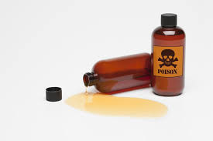
POISONING
Poisoning is any substance that causes injury, illness or death when introduced into the body.

Slide 40
TYPES OF POISONING
Ingested poisons re introduced through the mouth by eating or drinking poisonous substances.
Inhaled poisons are introduced through the lungs by inhaling industrial gases, fumes from fire, chemical vapors and petrol and engine exhaust.
Absorbed poisons are absorbed through the skin via contact with poisonous sprays such as pesticides and insecticides.

Slide 41
POISONING
Do’s :
Check the danger, response, airway, breathing and the blood circulation of the victim
Give large quantities of cold water to dilute down the poison
Monitor vital signs and prevent shock
Observe the amount and color of vomitus
Check for foreign matter in his or her mouth and remove it. so that he/she can breath freely
Place the patient in the recovery position and wait for medical assistance.
Send to hospital

Slide 42
DOG BITES
Aim
To prevent rabies
To reduce the risk of infection
To get medical aid as soon as possible.

Slide 43
DOG BITES
Do’s :
Wipe the saliva away from the wound using a clean cloth or handkerchief.
Wash the wound thoroughly with plenty of soap and water.
Cover the wound with a dry, sterile dressing.
Get medical aid or send the patient to the hospital as soon as possible.

Slide 44
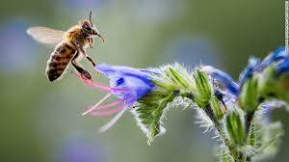
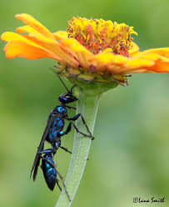
INSECT BITES – BEES, MITES, LEECHES & WASPS
Symptoms :
lots of pain
Swelling
Do’s:
A sting should be removed with forceps or with the tip of a sterilized needle
Clean the area and apply onion juice on the affected area which helps to reduce pain

Slide 45
FOREIGN BODIES IN EAR
FOREIGN BODIES:
Dust, small particles of wood, coal, glass, insects, acid, sand, chalk dust etc
EAR:
If it is an insect fill the ear with warm salt water.
The insect will float up and can be removed easily.

Slide 46
FOREIGN BODIES IN EYES
Dust in eyes- Instruct him not to rub the eyes
Wash the eye in a dish of water by opening and closing the eye lid.
When chemicals are splashed into the eye, thoroughly wash of eyes to take out the acid.
Pull down the lower eye lid and inspect in good light. If a foreign body is seen remove it with the corner of a clean handkerchief.

Slide 47
FOREIGN BODIES IN NOSE
Usually peas, beans, piece of pencil, rubber are put into the nose by children.
Ask the patient to breathe through the mouth as the foreign body may get lodged into the respiratory tract.
Make the patient sneeze, by this foreign body may be expelled
Seek medical aid

Slide 48
FOREIGN BODIES IN THROAT
Coin, marble, seed, fish bone etc.
Make the patient eat cooked potato, banana, soft bread etc.
It helps the swallowed object to pass down
Examine the stool next day for the foreign body
If the patient has swallowed sharp objects like open safety pin, nail, false teeth etc. get the doctor immediately.

Slide 49
EMERGENCY METHODS OF MOVING CASUALTIES
One Man Human Crutch
Conscious
Able to walk with some assistance
Pick-a-back
Conscious
Light weight
Able to hold on using arms
Cradle method
Light weight
A child

Slide 50
EMERGENCY METHODS OF MOVING CASUALTIES
Fore Method
When pick-a-back or fireman’s life method cannot be used to carry a heavy casualty down the staircase
Fireman’s Lift
Conscious
Unconscious
Light-weight
Double Human Crutch
Conscious
Able to walk with some assistance

Slide 51
EMERGENCY METHODS OF MOVING CASUALTIES
Two-handed Seat
Unable to walk with assistance
Able to use his arms to support
Three-handed Seat
Unable to walk with assistance
Usually with injury on one leg
Able to use his arms to support

Slide 52
EMERGENCY METHODS OF MOVING CASUALTIES
Four-handed Seat
Unable to walk with assistance
Able to use his arms to support

Slide 53
EMERGENCY METHODS OF MOVING CASUALTIES
Fore and Aft Method
Unconscious
Sustained abdominal injury

Slide 54
POINTS TO REMEMBER
Medical emergencies can happen anytime.
Act quickly, calmly, and correctly.

